Slide 1
Unit 3 - Lesson 6
Intro to Programming

Slide 4
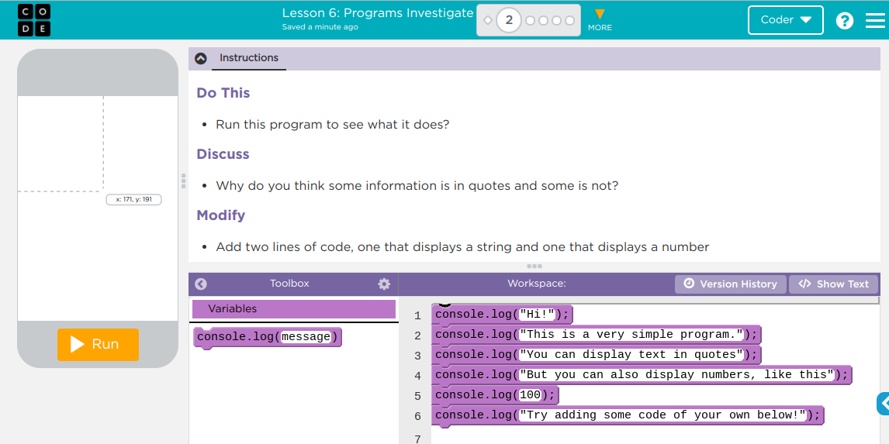
Unit 3 Lesson 6 - Activity
Intro to Programs
You and your partner should:
Work together to complete the “Do This”
Talk through the “Discuss” prompts together
“Modify” the code to follow the directions given
Be prepared to share your discussions with the class

Slide 6
Unit 3 Lesson 6 - Wrap Up
Prompt:
Think about your experiences today and in the previous lesson. How is a programming language different from natural language?

Slide 7
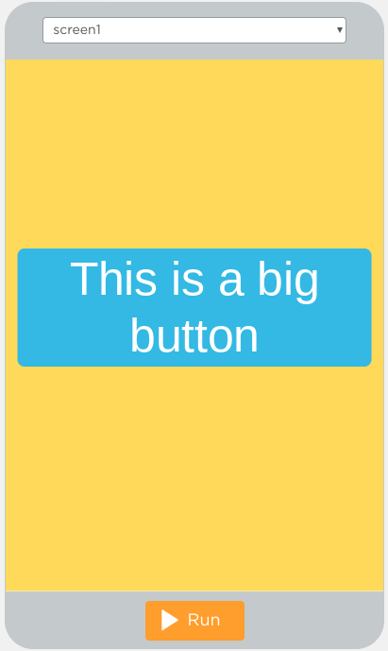
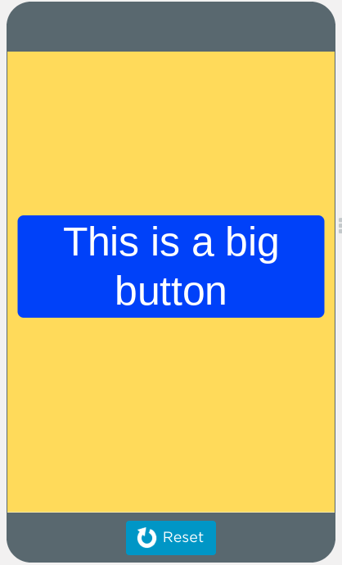
Unit 3 Lesson 6 - Wrap Up
Program Statement: a command or instruction. Sometimes also referred to as a code statement.
Program: a collection of program statements. Programs run (or “execute”) one command at a time.
Command Runs (yellow outline while running)
Before
After

Slide 8
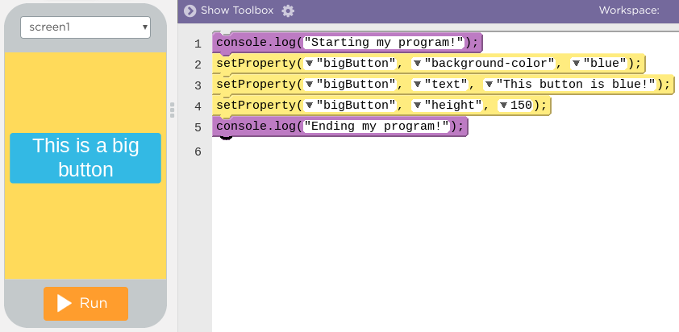
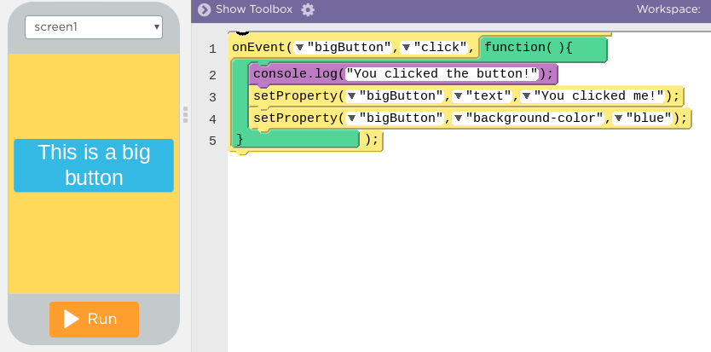
Unit 3 Lesson 6 - Wrap Up
Two different ways for programs to run
Sequential Programming: program statements run in order, from top to bottom.
No user interaction
Code runs the same way every time
Event Driven Programming: some program statements run when triggered by an event, like a mouse click or a key press
Programs run differently each time depending on user interactions

Slide 9
Unit 3 - Lesson 7
Debugging

Slide 11
Unit 3 Lesson 7 - Warm Up
Prompt:
Your friend calls and says "I can't get music to come out of my speakers”
Write a quick list of everything you'd ask them or have them check to try to fix the problem.

Slide 13
Unit 3 Lesson 7 - Activity

Slide 14
Unit 3 Lesson 7 - Activity
Debugging: the process of finding and fixing problems in code
Describe The Problem What do you expect it to do? What does it actually do? Does it always happen? | Hunt For Bugs Are there warnings or errors? What did you change most recently? Explain your code to someone else Look for code related to the problem
Try Solutions Make a small change | Document As You Go What have you learned? What strategies did you use? What questions do you have?

Slide 16
Unit 3 Lesson 7 - Wrap Up
Prompt:
Share any debugging tips you recorded today with your neighbor.
Be ready to share with the class.

Slide 17
Unit 3 Lesson 7 - Wrap Up
Debugging Strategies
Keep your code clean
Use clear, meaningful IDs for your elements
Keep your code organized in chunks that do the same thing
Use comments to explain your code
Write code using blocks
Run your code
Run your code a lot, every time you add a command or two
Slow down your code with the speed slider. Watch how it runs closely
Use console.log to get output. Add extra output statements throughout your code to get feedback on what parts are running.
Use classmates and resources
Talk out the problems with a partner or classmate
Compare your code to examples that you know work
Read documentation to know how a block is supposed to work
Hand trace your code to track what's happening.

Slide 18
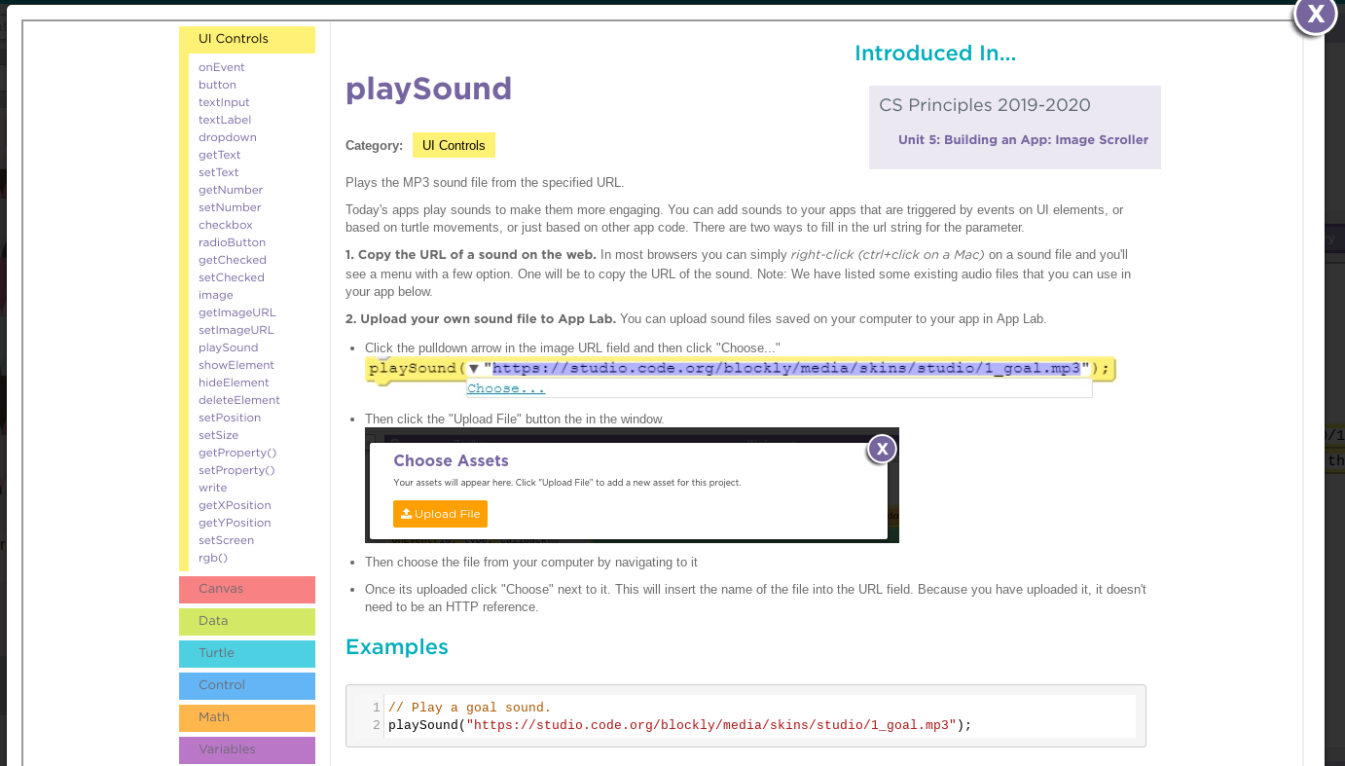
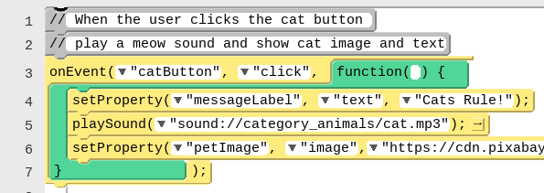
Unit 3 Lesson 7 - Wrap Up
Documentation: a written description of how a command or piece of code works or was developed.
Comment: form of program documentation written into the program to be read by people and which do not affect how a program runs.

